Slide 1
Compulsory English (BA-FY)- A Living God: Patrick Lafcadio Hearn
Dr. Nirmala S. Padmavat
Director, IQAC
Nutan Mahavidyalaya, Selu

Slide 2
A Living God: Patrick Lafcadio Hearn

Slide 3
INTRODUCTION
Patrick Lafcadio Hearn (1850-1904), also known by his Japanese name Koizumi Yakumo, was an international writer, translator and journalist in English, Greek and Japanese languages.

Slide 4
INTRODUCTION
Living God describes an important event from the lift of a prominent Japanese personality Goryo Hamaguchi (1820-1885), the owner of current Yamasa Corporation, who held different important political and administrative positions in Japan. The story narrates how Hamaguchi saved hundreds of lives in Hirogawa and Wakayama in 1854 when a divesting tsunami struck the peninsula.

Slide 5
After the tsunami, Hamaguchi spent his own money to construct a 600 meter protective wall having the width of 20 meters and the height of five meters which minimized the damages in the later tsunamis. He also worked in the field of education and established a private academy for learning Japanese fencing and Chinese classics. Goryo Hamaguchi became a living God due to his act of selflessness.

Slide 6
From the beginning of human history, people had to face natural disasters like floods, earthquakes, tsunamis, etc. the tsunami in recent past in India on Southern Coasts (2004) destroyed the lives of thousands of people. Japan is a nation where tsunamis and earthquakes have been occurring constantly.

Slide 7
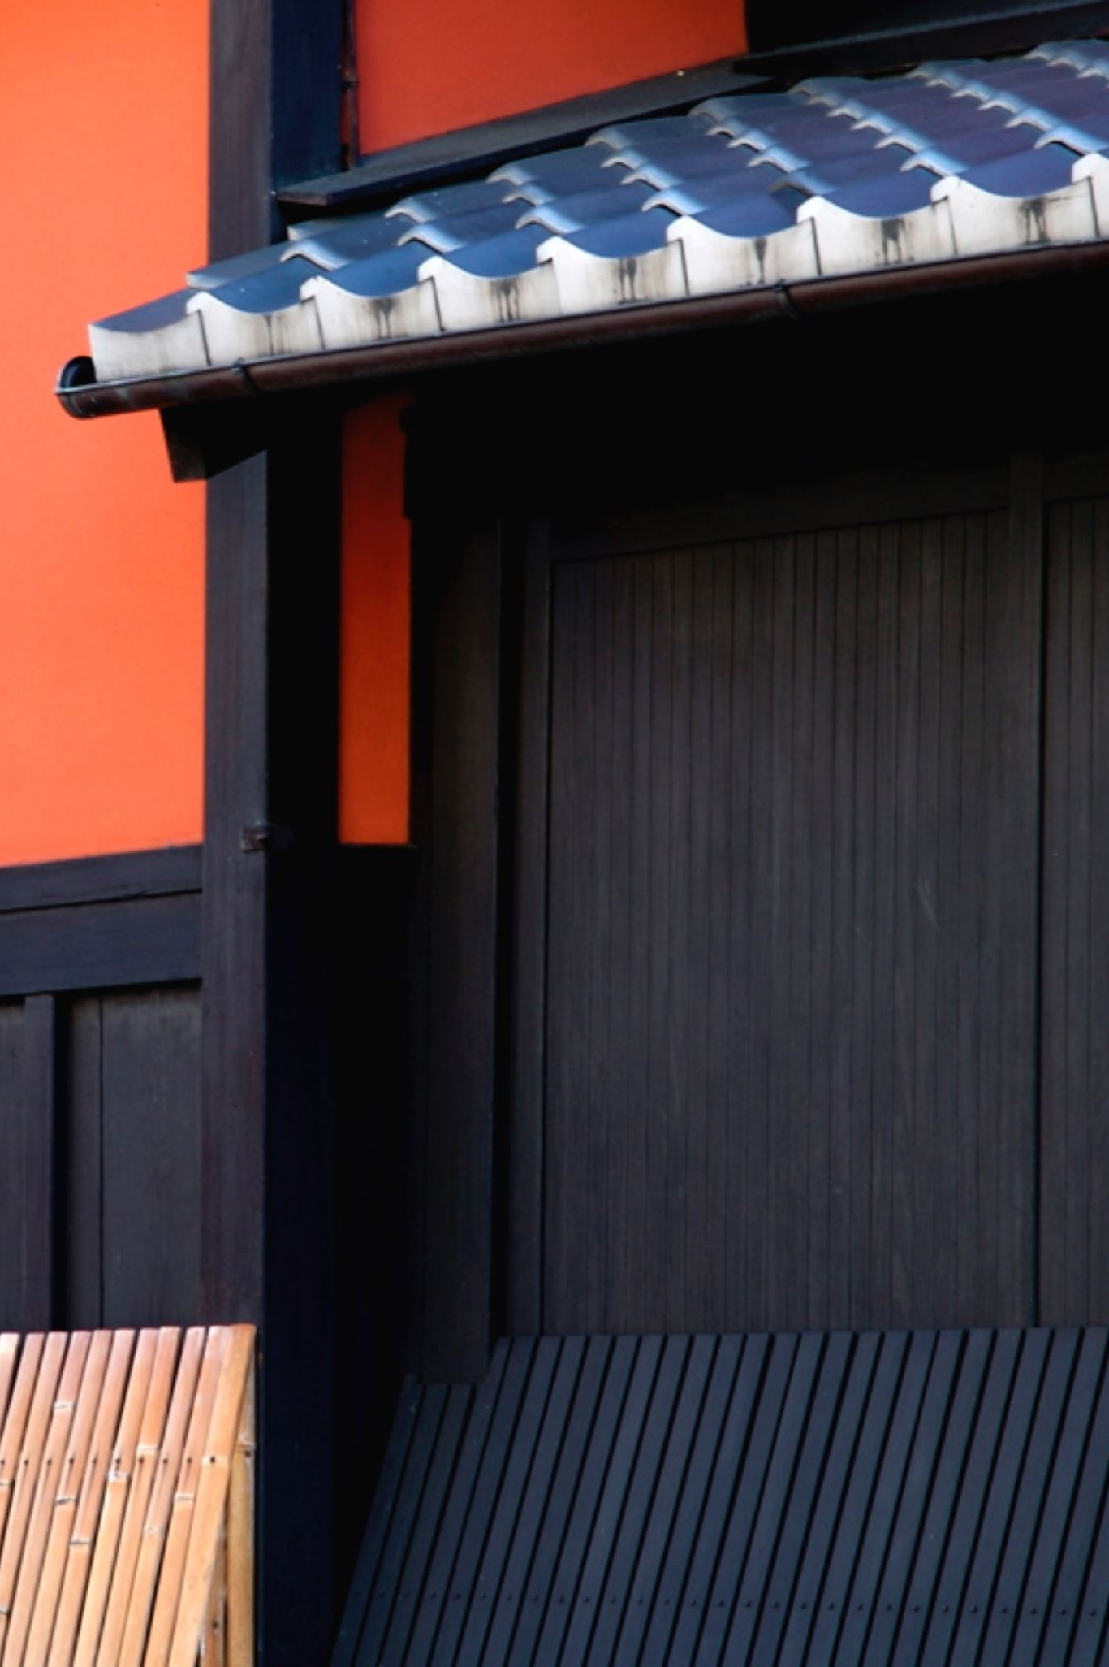
In this narrative about Hamaguchi, we learn how, sometimes, humans can face natural disasters with their alertness. The narrative refers to a custom in ancient Japan. According to the Shinto religious customs, certain persons, while still alive, were honored by having temples built for their spirits, and were treated like Gods, because of their extraordinary actions of kindness, courage, etc.

Slide 8
The story records an incident in the life of Hamaguchi. At the time of its occurrence, he was an old man and the most important resident (muraosa) of the village to which he belonged. He performed the role of the head man and settled disputes among the villagers, and maintained the law and order in the village. He was greatly respected because of this.

Slide 9
His house was located on a high land on the coast. The village was located on the shore. Hamaguchi could see the village from his house. One evening his family members had gone to the village for a celebration. Hamaguchi was not feeling well so he stayed at home with ten-year-old grandson.

Slide 10
As he was looking out from his balcony, he experienced an earthquake shock, but the earthquakes were usual in his area and people did not care about minor shocks. However, Hamaguchi felt that it was a strange earthquake. He thought it was a long, slow, spongy motion which came from underwater action very far away in the sea.

Slide 11
He felt that something unusual was happening. When he looked at the sea, it had become dark suddenly and the water was running away from the land. Suddenly, there was great ebb, the receding tide. The villagers also noticed this and they ran towards the sea to watch this unfamiliar scene.

Slide 12
Hamaguchi had never seen such ebb before. He sensed a tsunami to take place soon. But he had no time to send message to the villagers. The villagers were usually alarmed by the ringing of the big bell in the temple. Now, Hamaguchi did not have time to inform the village priest.

Slide 13
He called his grandson and asked him to bring a burning torch. He then went to his fields where hundreds of rice-stacks were kept. This rice was the produce of his fields and he had invested most of its money in the crop production. It was soon to be transported to the market. Hamaguchi lit all the rice stacks with the torch and there was a huge fire which could be seen from the village below.

Slide 14
His grandson could not understand why he had set his entire crop on fire. When the villagers saw the fire in the fields, they immediately hurried towards it where Hamaguchi waited for them. He told them to let it burn. The temple assistant saw it and rang the big bell to inform the villagers. Very soon most of the villagers reached the spot.

Slide 15
His grandson, now crying, told them that grandfather had set fire; he said grandfather had become mad. Hamaguchi agreed that he had set the crop on fire and asked whether all the villagers had come. The villagers could not understand the reason for his actions. Then, he pointed to the sea from where a huge tsunami was approaching.

Slide 16
The village was destroyed within moments. But all the villagers, as they were on the high ground, were saved. Hamaguchi had set fire so that the villagers would rush to his land. He did not care about his crop. He only wanted to save the lives of his fellow villagers. As a result of the fire, he had become a poor person.

Slide 17
Still he invited all the people to stay in his house which was the only house remaining in the village. The temple on the hill was also safe. The villagers could take shelter in these two places. In those days, the help from outside could not come quickly and it took several days for the villagers to recover from the loss.

Slide 18
They started revering Hamaguchi as a divine person because it was only due to his sacrifice that their lives were saved. They declared him a God and thereafter called him Hamaguchi Daimyojin, the living God. Even today, his temple stands in the village and the farmers pray to his spirit for strength and courage.

Slide 19
CONCLUSION
The story of Hamaguchi is an account of selfless action and presence of mind. Hamaguchi represents those people who do not care for personal wealth. It teaches us that we can save ourselves from calamities through our intelligent actions. The spirit of selflessness is a great quality. Hamaguchi was declared a living God because he earned the respect of the fellow human beings through his actions.

Slide 20
Thank you!

